Slide 1


cardiovascular disease
Research
ABDULRAHIM ALSHEHRI

Slide 2

OUR BIG IDEA
Our mission is to become the recognized leader in the target market for providing healthcare research tailored to each client needs and expectations

Slide 3
index
Introduction
Research Questions
Charts
Findings
Conclusion
Tools
Ending

Slide 4
introduction
Cardiovascular disease and includes a number of conditions affecting the structures or function of the heart, including coronary artery disease and vascular (blood vessel) disease. Cardiovascular disease is by far the leading cause of death in the world.

Slide 5
Research questions :
How much smoker and non smoker along with gender?
How much people infected with cardiovascular along with gender?
What is the relationship between smoker and non smoker along with cardiovascular?
What is the relationship between the age and cardiovascular?
What is the relationship between the age and cholesterol?
What is the relationship between the cardiovascular and cholesterol?
What is the relationship between smoker and non smoker along with cholesterol?

Slide 6
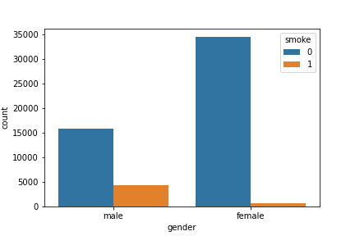
How much smoker and non smoker along with gender?

Slide 7
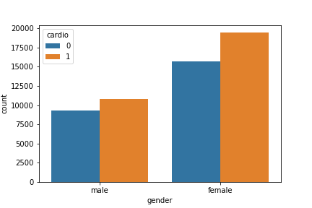
How much people having cardiovascular along with gender?

Slide 8
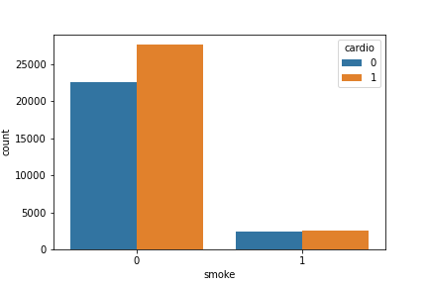
What is the relationship between smoker and non smoker along with cardiovascular?

Slide 9
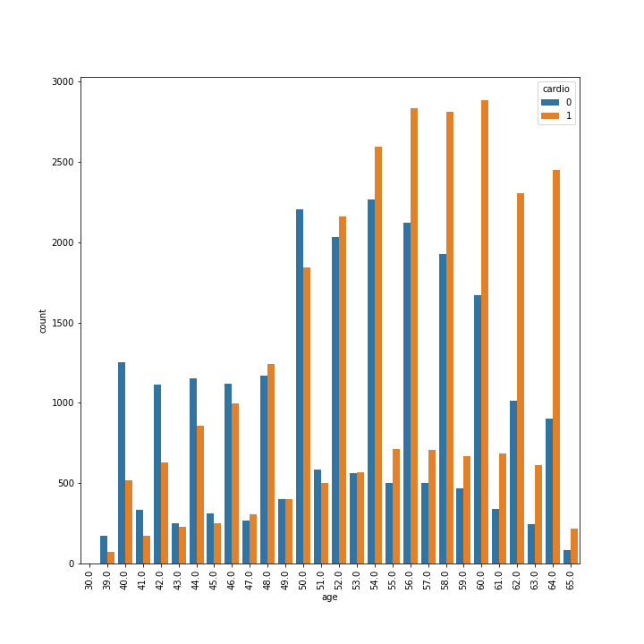
What is the relationship between the age and cardiovascular?

Slide 10
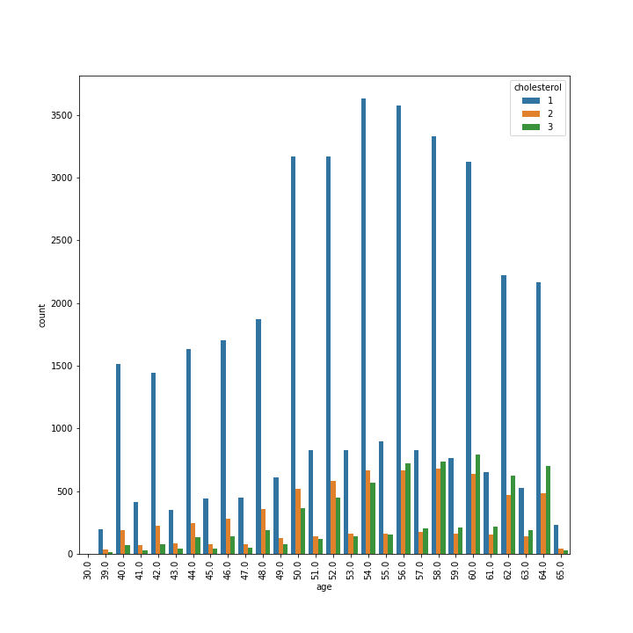
What is the relationship between the age and cholesterol?

Slide 11
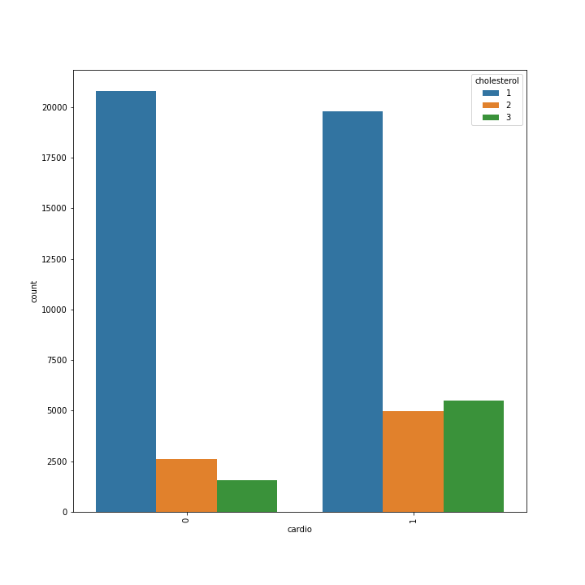
What is the relationship between the cardiovascular and cholesterol?

Slide 12
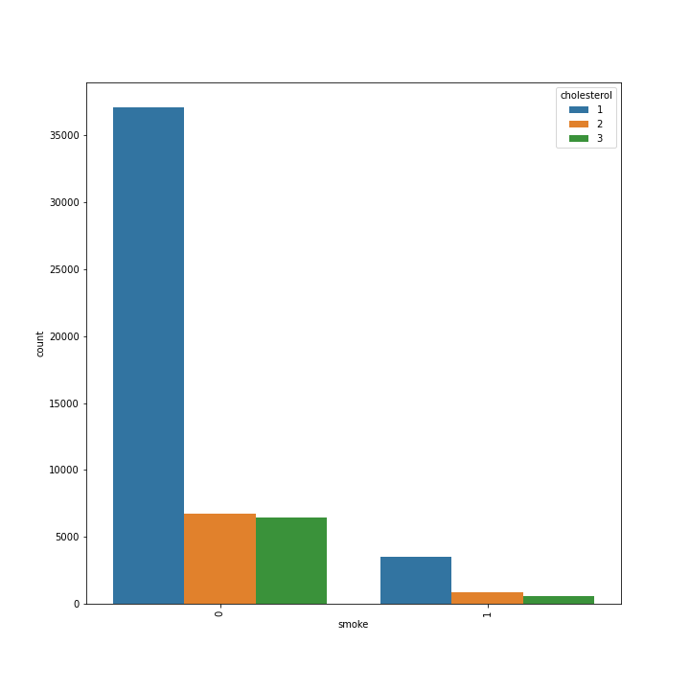
What is the relationship between smoker and non smoker along with cholesterol?

Slide 13
Our findings :
The number of male smoking is more than the number of female smoking.
The number of female having cardiovascular disease is more than male.
The non smoker more likely getting cardiovascular disease more than smokers
When people get elder they more susceptible to cardiovascular disease the maximum risk is in age 60
When people get elder they more susceptible to cholesterol disease the maximum risk is in age 54
The people with cardiovascular disease is more likely to holding on of three type of cholesterol
The non smoker is more likely to get cholesterol diseases more than the smokers

Slide 14
Conclusion:
We suggest to lunch awareness program that include next topics:
Smoking and its side effects: We can target male.
Ways of preventing Cardiovascular and cholesterol disease: We can target female with the age between 55 to 60 because they are more effected.

Slide 15








Tools:

Slide 16
Thank You
ABDULRAHIM ALSHEHRI

